Slide 1
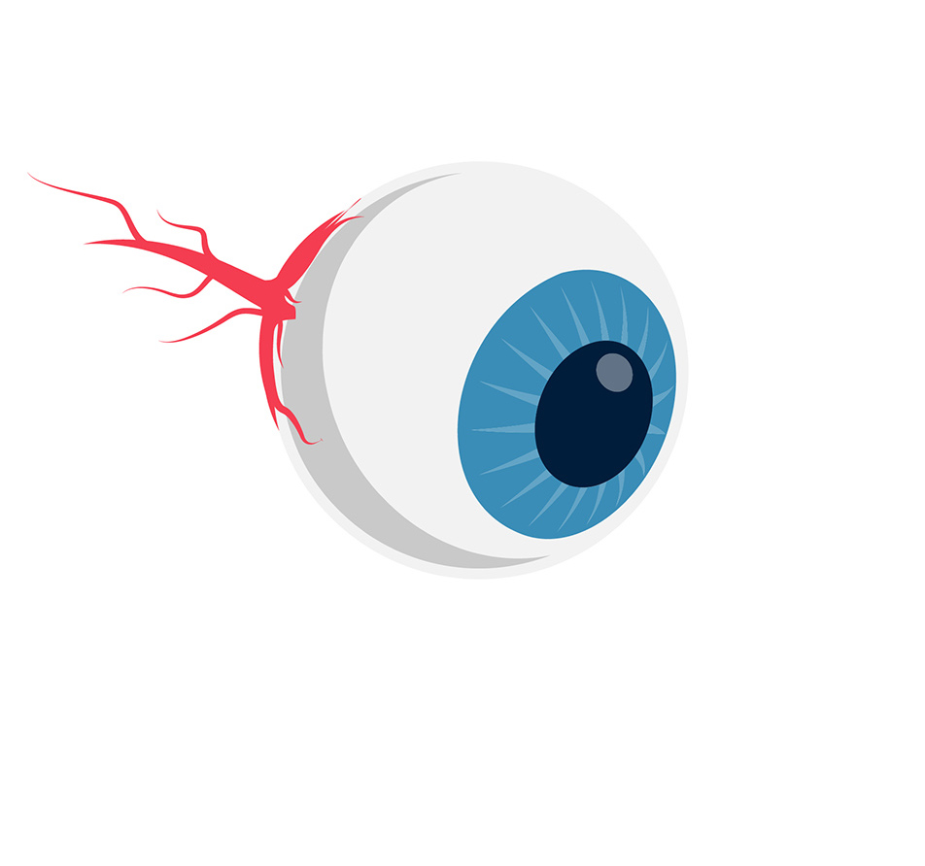
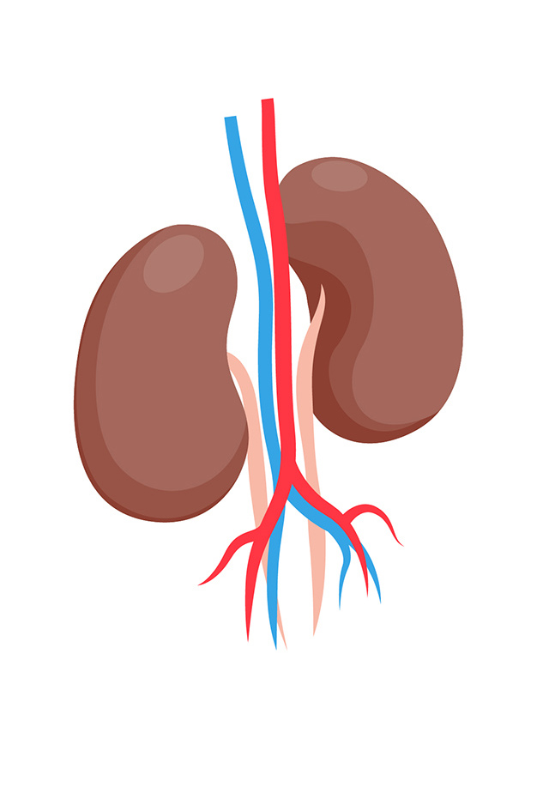

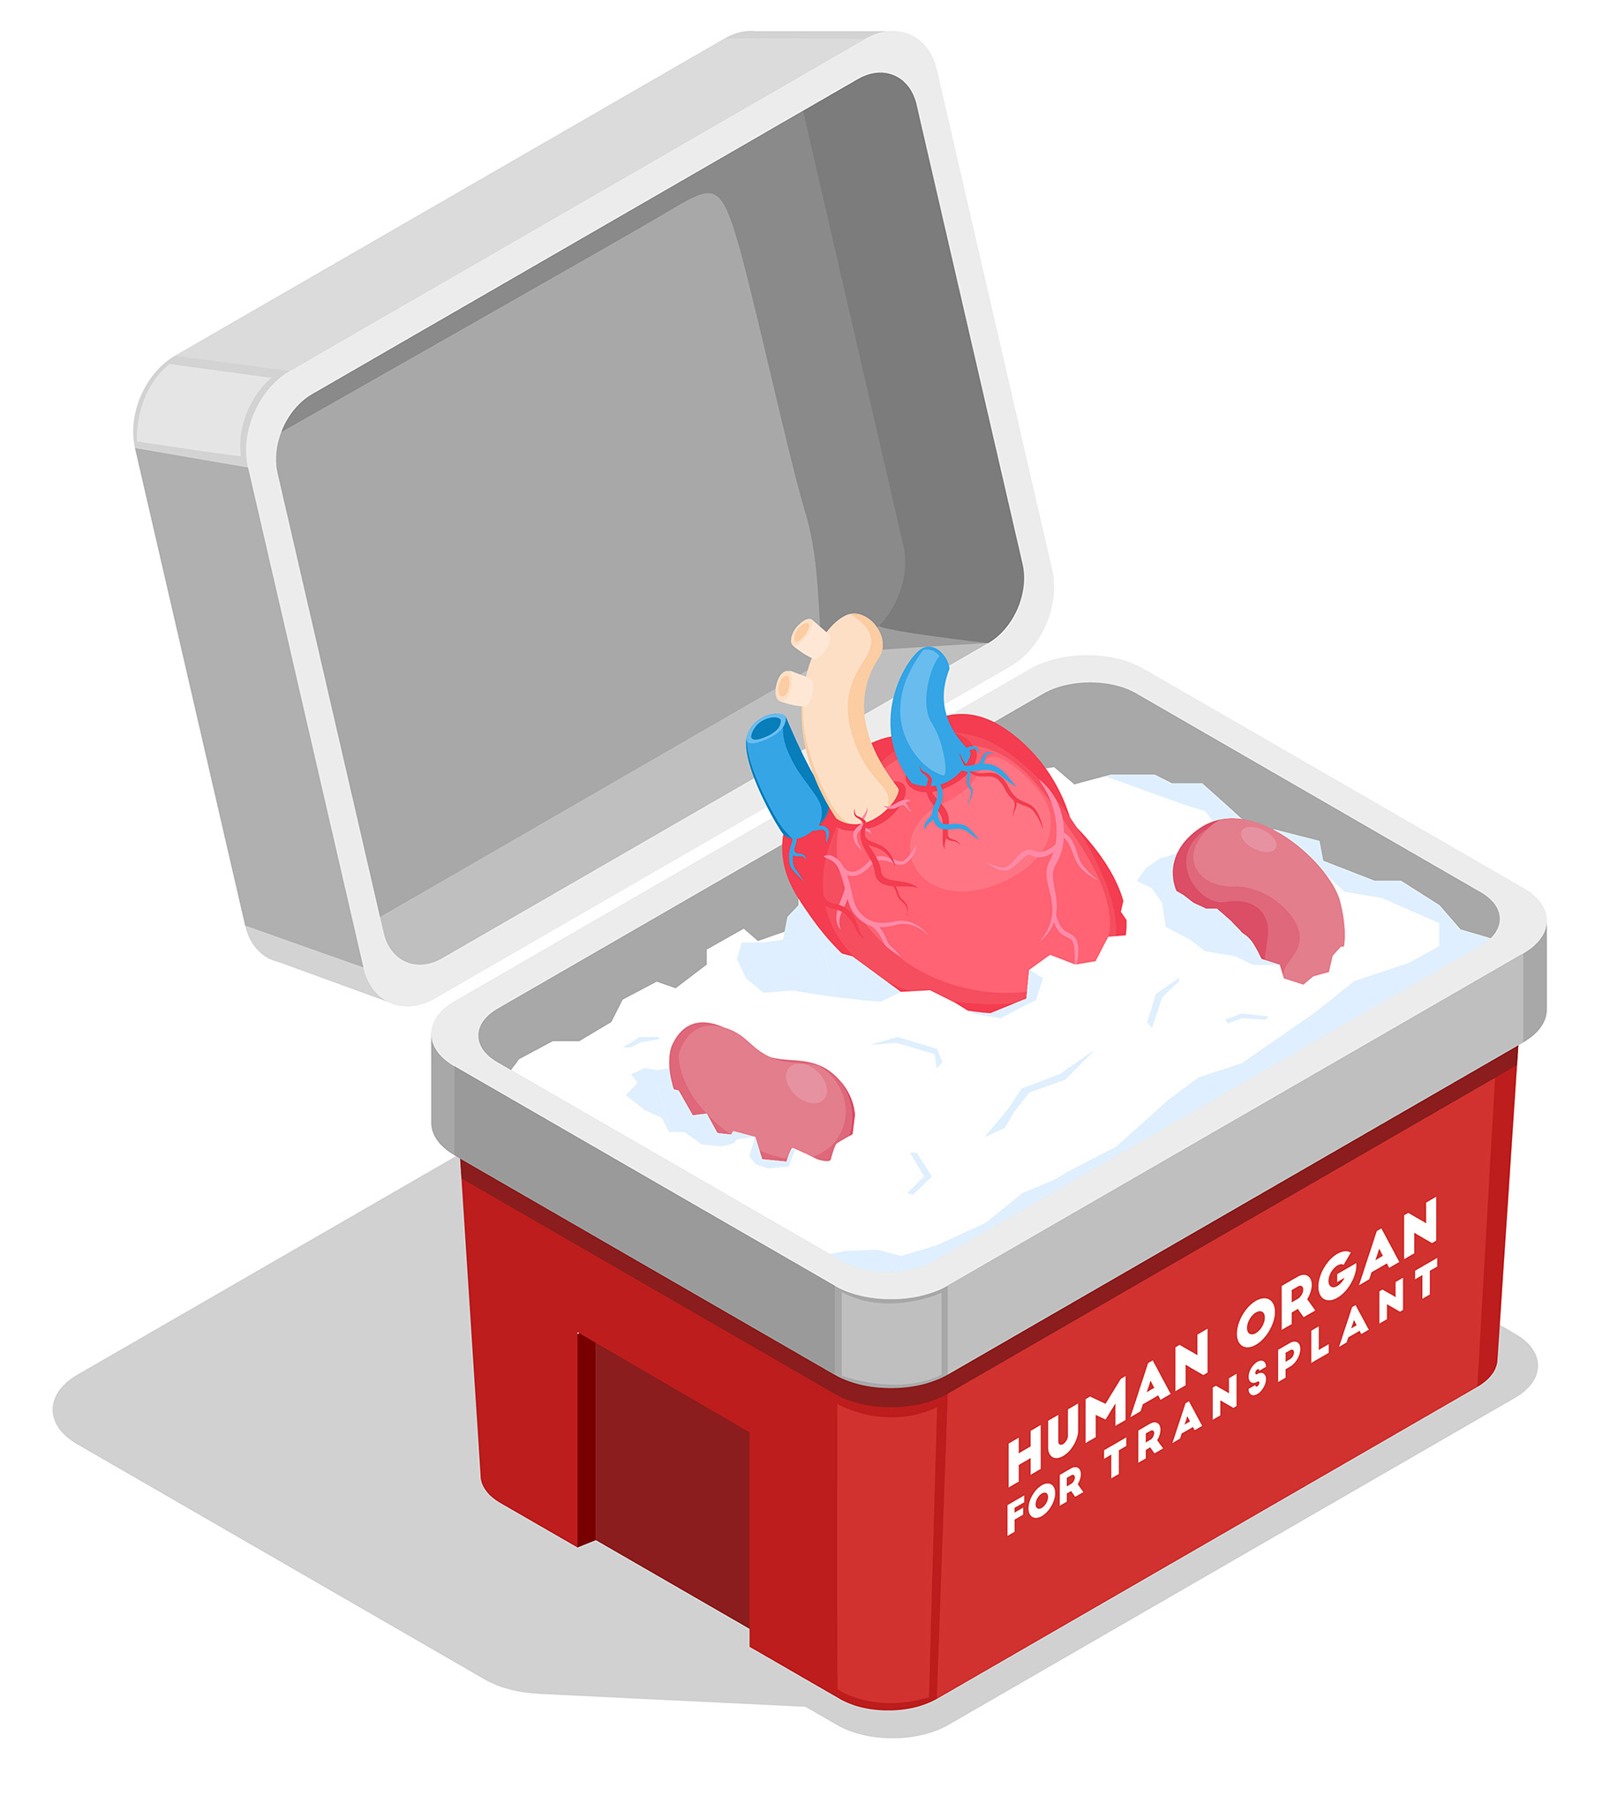
BLOOD & ORGAN DONATION MANAGEMENT SYSTEM
Team Mates
VenuGopal V
Shijo M
Ramesh S
Shyjin A
Project Guide
Mr. M. Ajin
Assistant Professor
Department of Computer Science and Engineering

Slide 2
CONTENTS
ABSTRACT
INTRODUCTION
OBJECTIVE
LANGUAGE USED
EXISTING SYSTEM
PROPOSED SYSTEM
PROJECT SCOPE
DATA FLOW DIAGRAM
MODULES
PROJECT SCREENSHOT
CONCLUSION

Slide 3
ABSTRACT
Blood and organ donation management system is a DBMS(Database Management System) based software application. This Application acts as an essential role in saving human lives, and its main aim is to help the user get the required blood and organs at the correct time. This app enables users to find blood and organs in emergency situations. Users need to register with the application which is available on the application. And also, they can get brief information on the donor’s contact details including their location. The user can Contact them by making a call using this application.

Slide 4
INTRODUCTION
The main aim of developing this application is to provide blood to the people who require blood and organs. The numbers of persons who need blood are increasing in massive amounts day by day. Using this system user can search blood groups available in the city, and he can also get the contact number of the donor who has the same blood group he needs. To help people who need blood, this application is used effectively for getting the details of available blood groups, and also to get the contact number of the donors with the same blood group and within the city. Using this Blood and Organ bank management system application people can register himself or herself who want to donate blood.

Slide 5

CONTINUATION
To log in the application, they have to enter their contact information like address mobile number, etc. This blood bank management system is a system based application. When a Human/Person wants to donate blood, he/she has to register in the application. Donor registration is effortless; to get register to the system, he has to fill up the registration form.

Slide 6
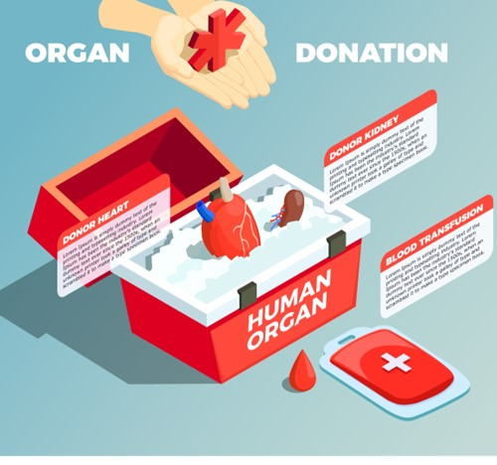
OBJECTIVE
The Objective of this application is to design and maintain necessary information of the Patients, Donors, and report details for any bio-related organization. This application also has a login page where the user is required to register and only then they can view the availability of blood and organ, and even register to donate blood if he/she wishes to.

Slide 7
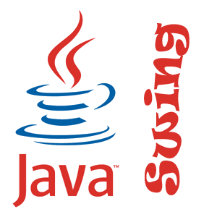

LANGUAGES USED
Front-End
Back-End
Java Swing
My SQL

Slide 8
EXISTING SYSTEM
There are less applications in the market related to these organs to donate and request organs, we created this application to manage all those things stuff like donating and requesting. So many people are dying due to organ sufficiency and they can't run to hospitals in a critical time there is no guarantee that specific organ is present at that time at region/state by overcoming all those things we created this application Blood and organ donation management system here they can easily register themselves for donation and they easily request for an organ Our team from various hospitals from various states will collect data from hospitals update data using MySQL.

Slide 9
PROPOSED SYSTEM
Blood and organ donation management system will be a DBMS-based software application. The purpose of the system is to simplify and automate the process of searching the blood and organ in case of emergency and maintaining the records of blood donors, recipients, blood donation programs, and blood stocks in the bank. Using this application organ seekers can search for organ donors and can call or message the donors through this application. This application can also be used by organ donors and seekers where a person can register for organ donation. The proposed system will contain a Directory that includes details of all Blood banks across India. Users can search Blood bank using the name of the State or city.

Slide 10
PROJECT SCOPE
The scope of a Blood and organ donation management system software can vary depending on the needs of the specific organization or jurisdiction implementing the system. The software can be designed to cover various aspects of the process, including donor registration, Donor blood group, and Organ stock details. However, the ultimate goal of any software in this domain is to improve the efficiency, transparency, and accuracy of organ donation and transplantation services, and to increase the chances of success for patients in need of organ transplants.

Slide 11
DATA FLOW DIAGRAM
A Data Flow Diagram (DFD) is a graphical representation of the “flow” of data through an Information System. A DFD also can be used for the visualization of data processing. It is common practice for design to draw a context-level DFD first which shows the interaction between the system and outside entities. This context-level DFD is then “exploded” to show more detail of the system being modeled.

Slide 12
DFD FOR ADMIN LOGIN
After entering the login page of the application, the admin can choose the ADMIN LOGIN option where they are asked to enter a username & password, and if he/she is a valid user then the admin login page will be displayed.
CHECK DATABASE
ENTER INTO APPLICATION
ENTER USER ID, PWD
CHECK VALIDITY
ADMIN
if valid
HOME PAGE

Slide 13
DFD FOR ADMIN
Update Details
Stock details
ADMIN
Delete Donor Details
Search Donor Details

Slide 14
Login
Donor Register
Update Donor Details
Manage Organ Details
USER
Manage Blood Group Details
ADMIN
Delete Donor Details
USECASE FOR BLOOD AND ORGAN DONATION PROCESS

Slide 15
MODULES
Admin Module
Donor Module
Manage the Number of Blood packets and organs Available.
ADMIN
This module can be accessed only by the admin of the system. Admin can log into the system by entering the user ID and password. Admin can manage donor details and he can add or remove any user from the system. The admin can control the following features:

Slide 16
CONTINUATION
❖ ADMIN MODULE
⮚ Add donors
⮚ Update donor details
⮚ View donor details
⮚ Search and delete donor record
⮚ Stock increase
⮚ Stock decrease
⮚ Stock details

Slide 17
DONOR
This module can be accessed by donors and hospital authorities. Donors can log into the system by entering the user ID and password. After entering this module, the donors can use the following modules:
❖ DONOR MODULE
⮚ Login/Logout
⮚ Donor Registration

Slide 18
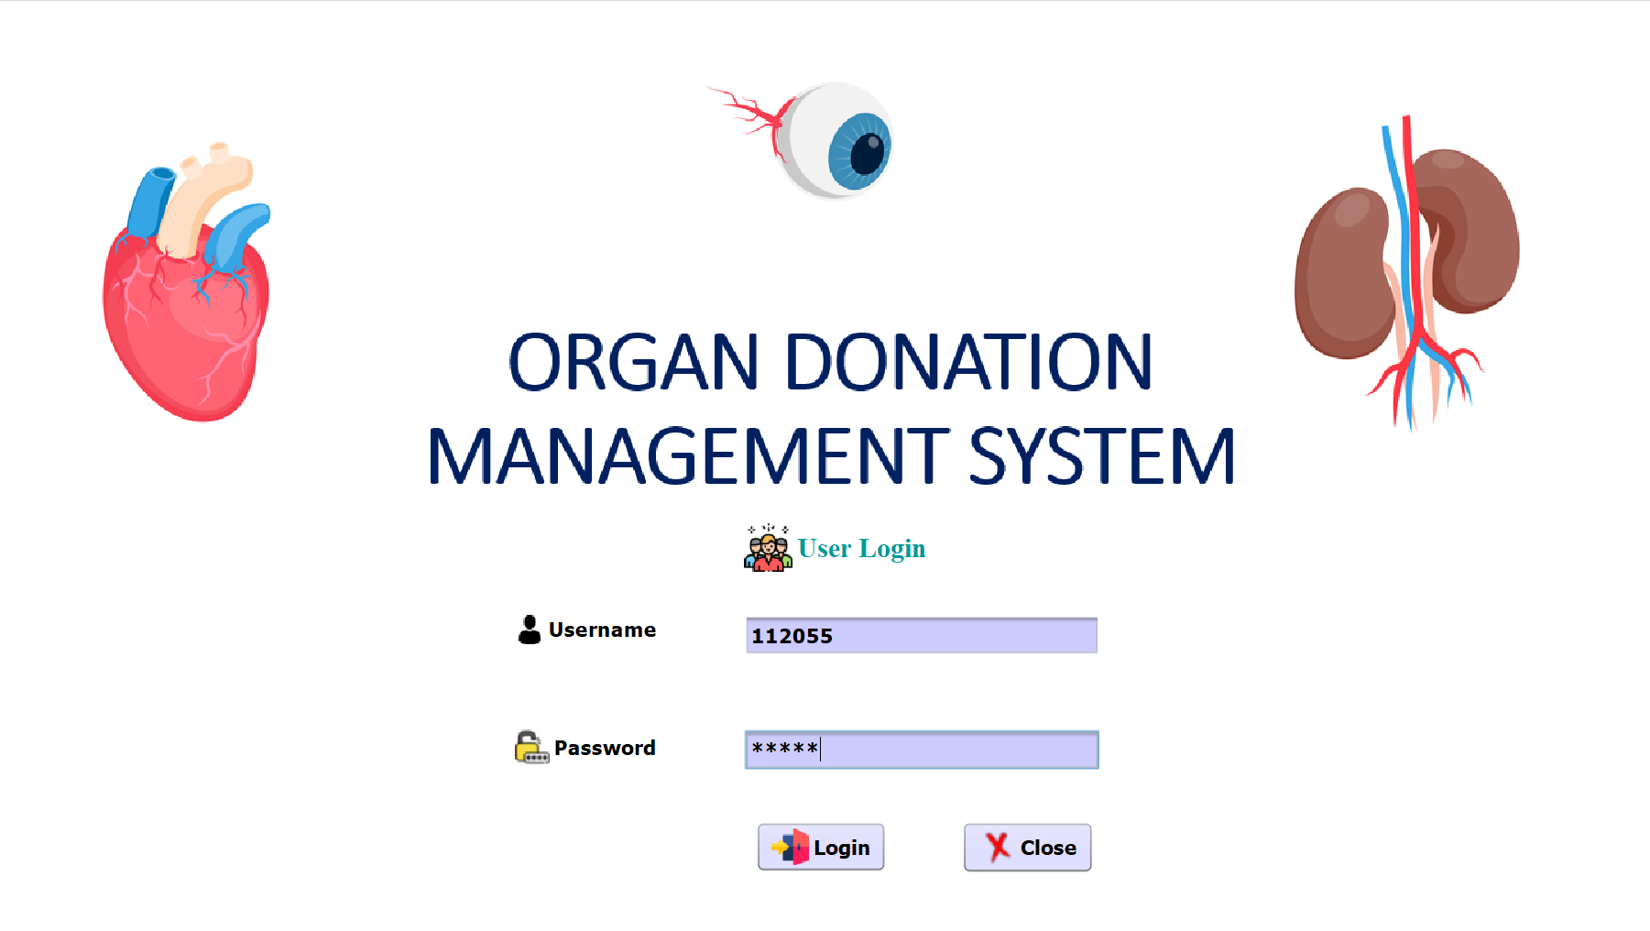
PROJECT SCREENSHOT
Login Page

Slide 19
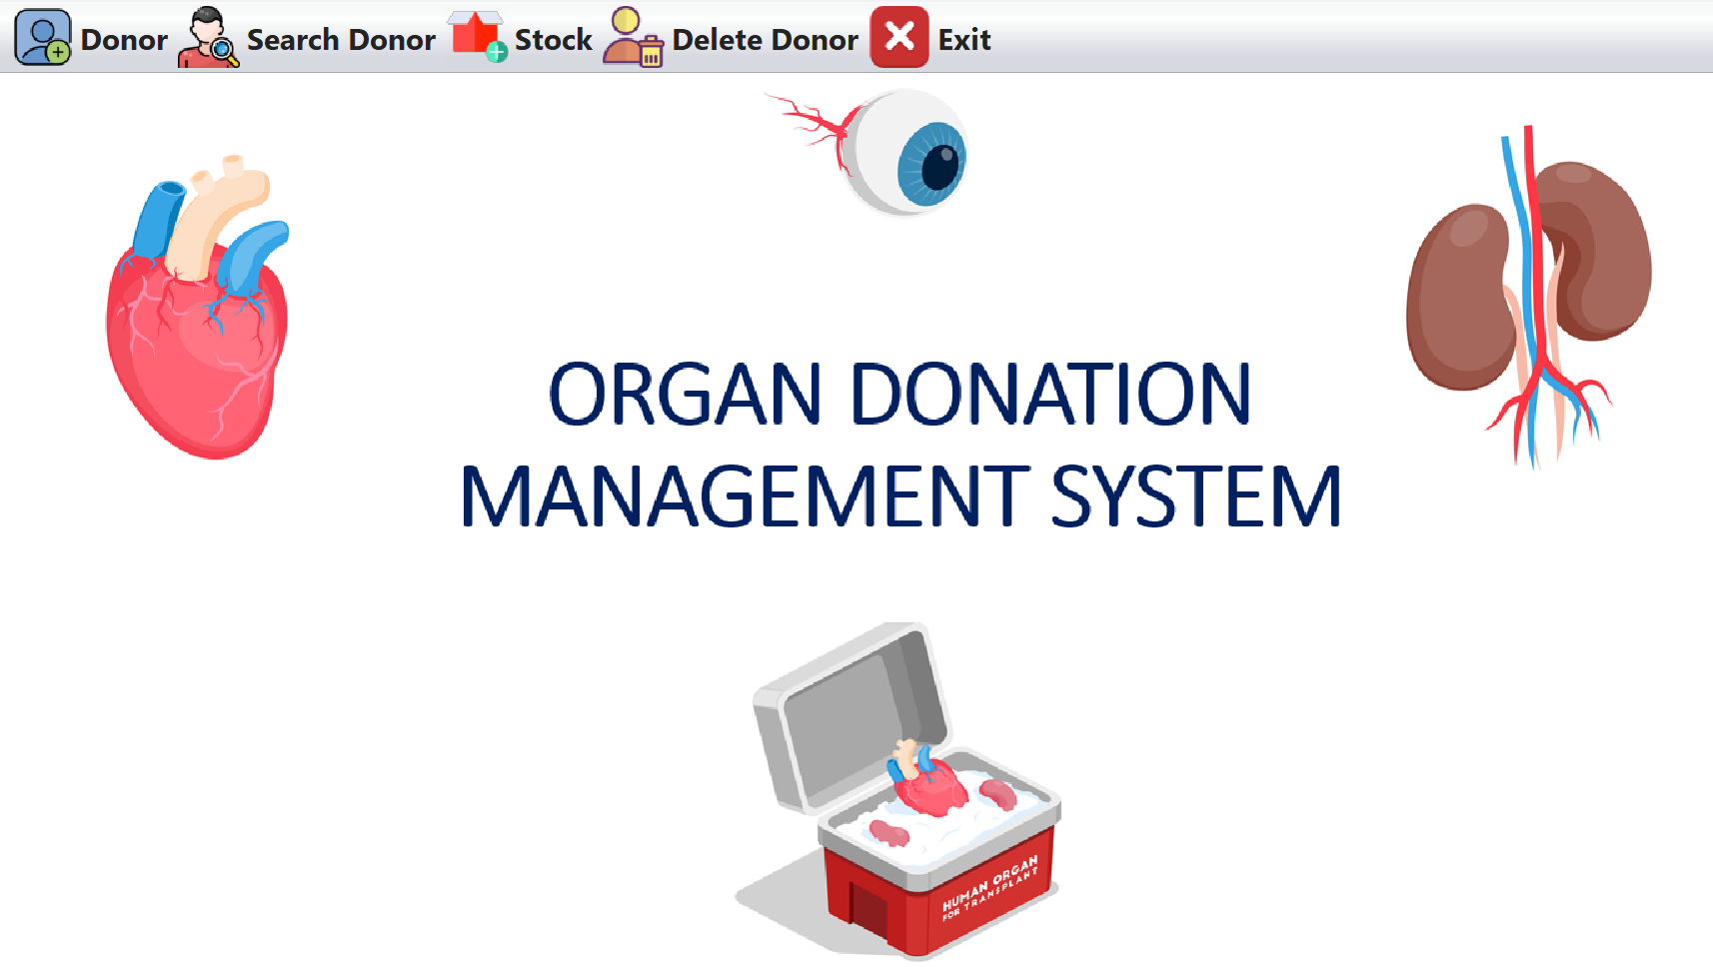
HOME PAGE

Slide 20
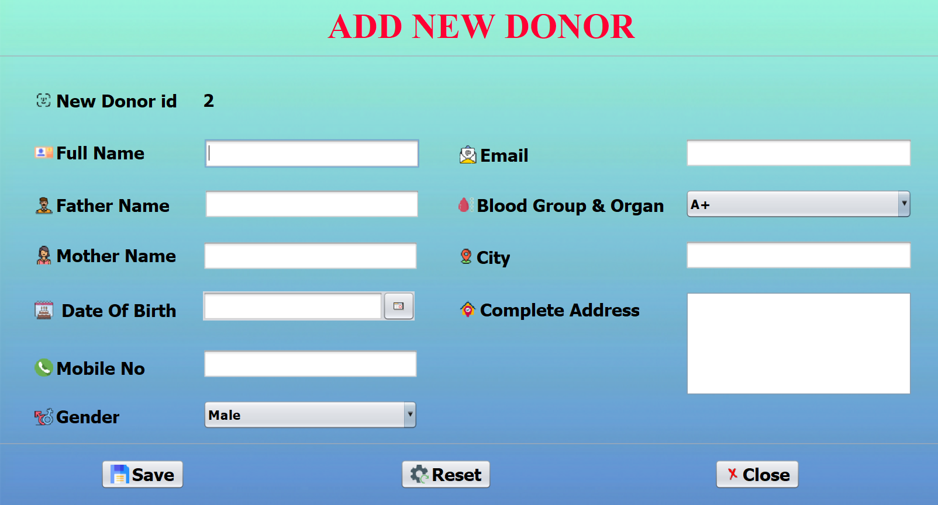
DONOR REGISTRATION PAGE

Slide 21
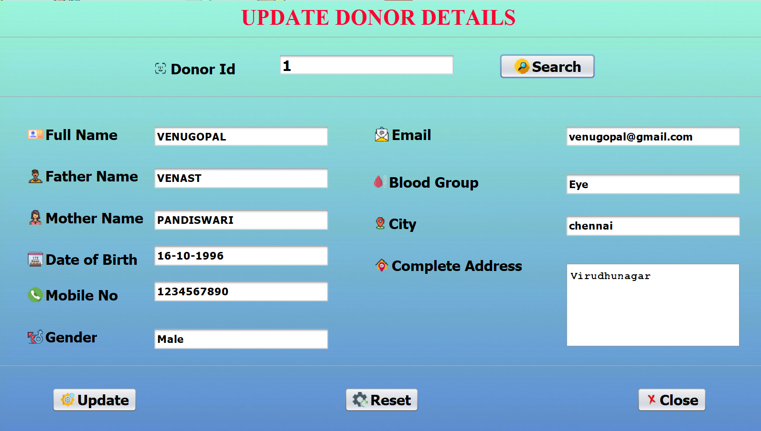
UPDATE DONOR DETAILS

Slide 22
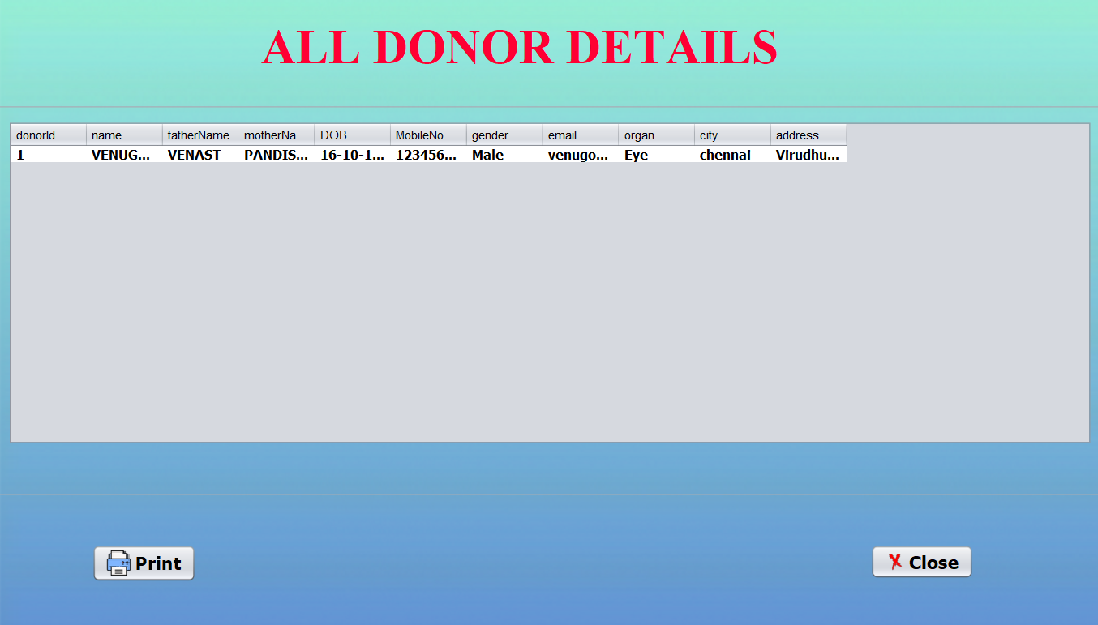
REGISTERED DONORS

Slide 23
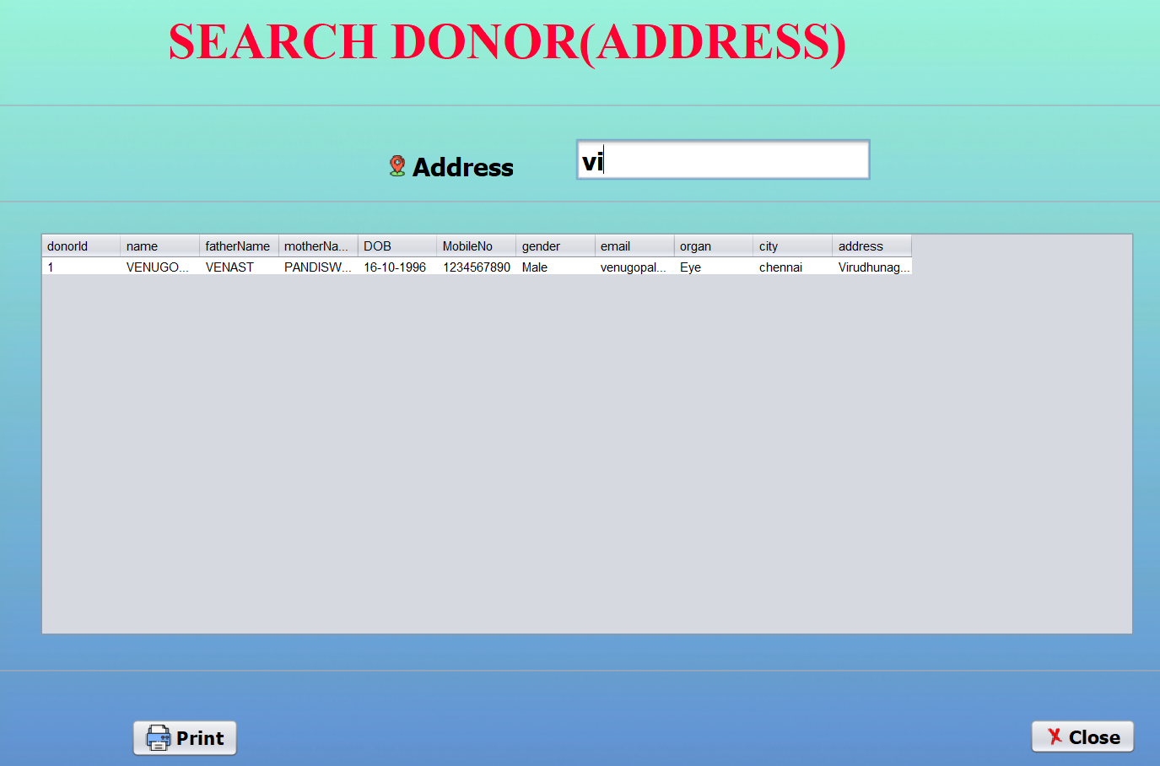
SEARCH BY DONOR LOCATION

Slide 24
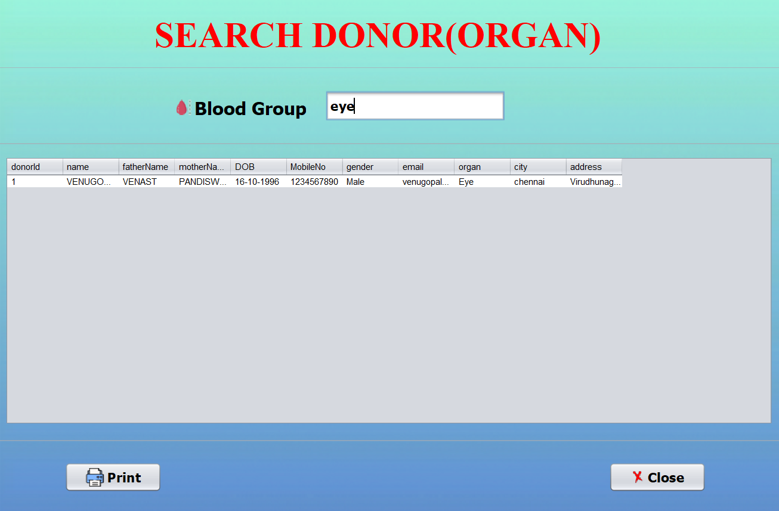
SEARCH BY DONOR ORGAN

Slide 25
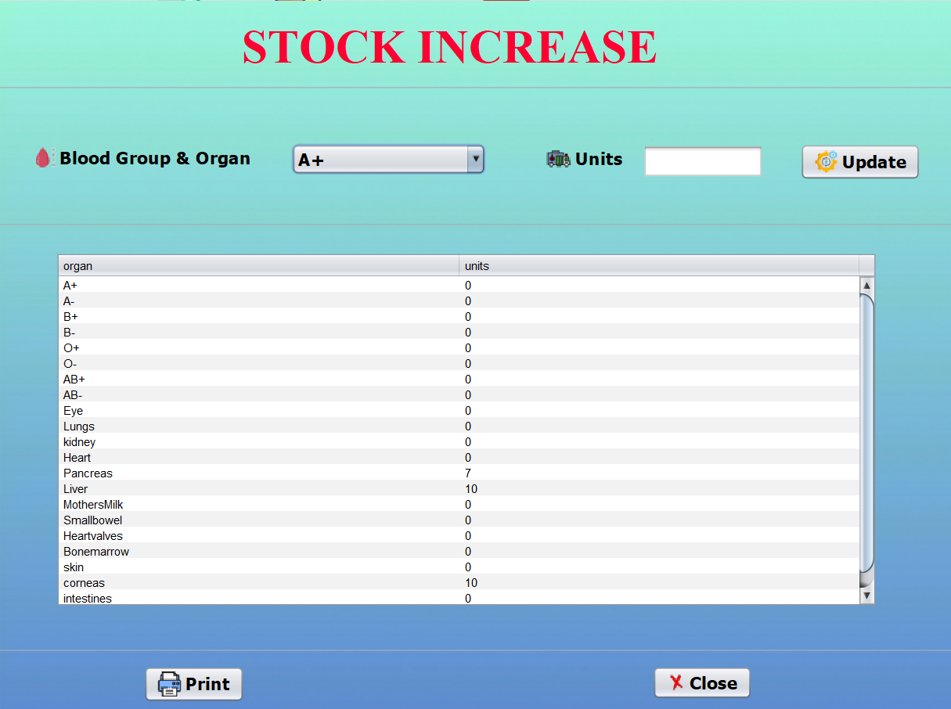
STOCK INCREASE

Slide 26
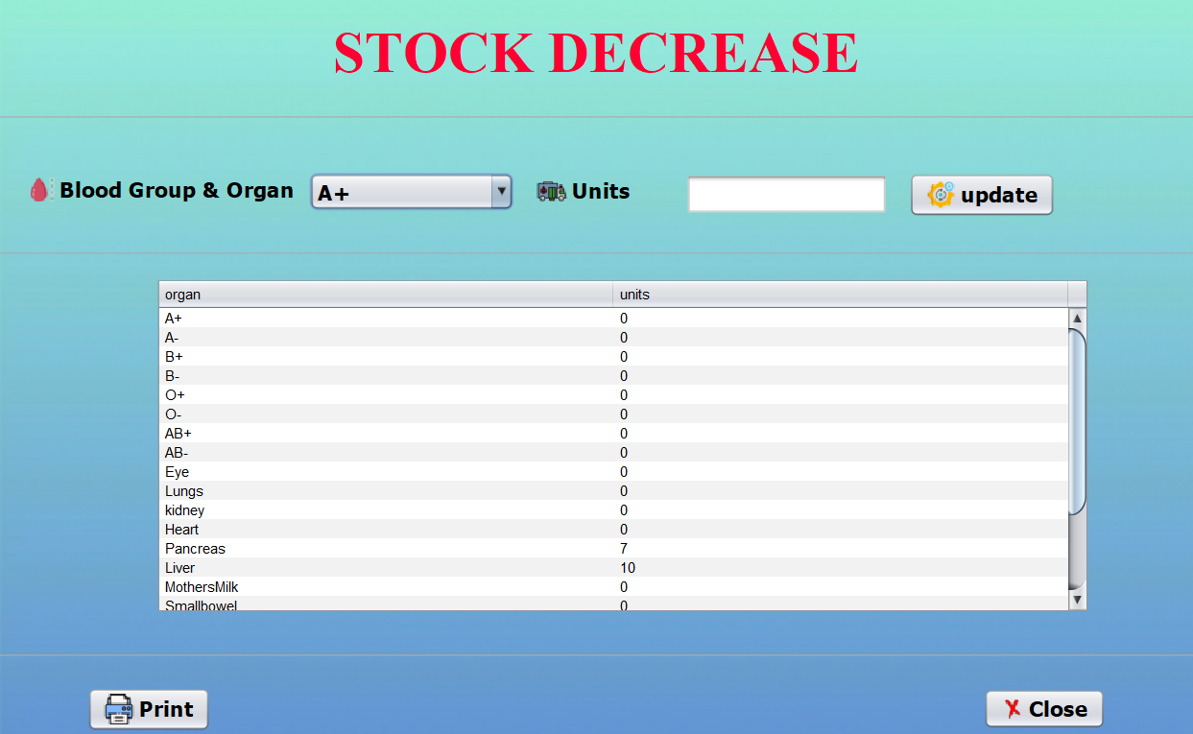
STOCK DECREASE

Slide 27
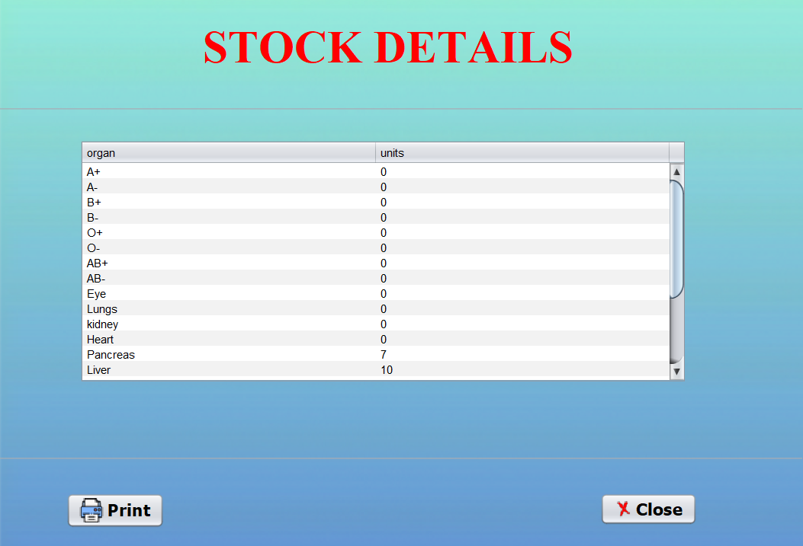
STOCK DETAILS

Slide 28
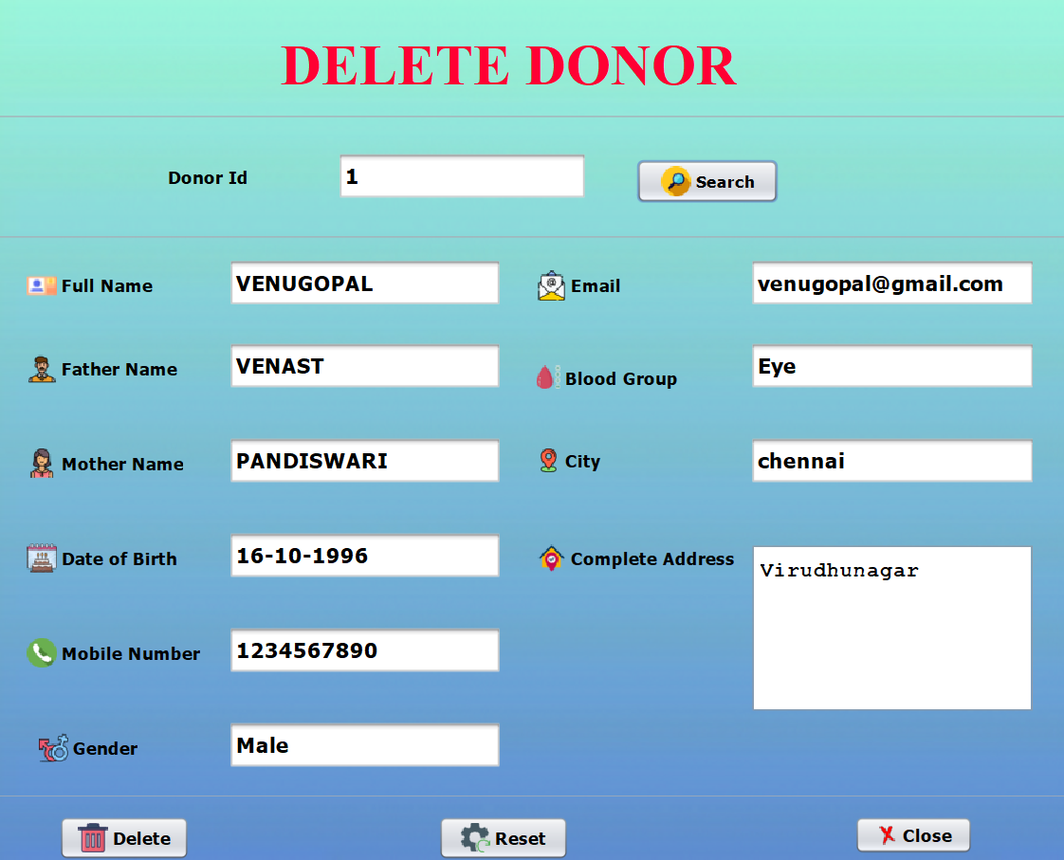
DELETE DONOR DETAILS

Slide 29
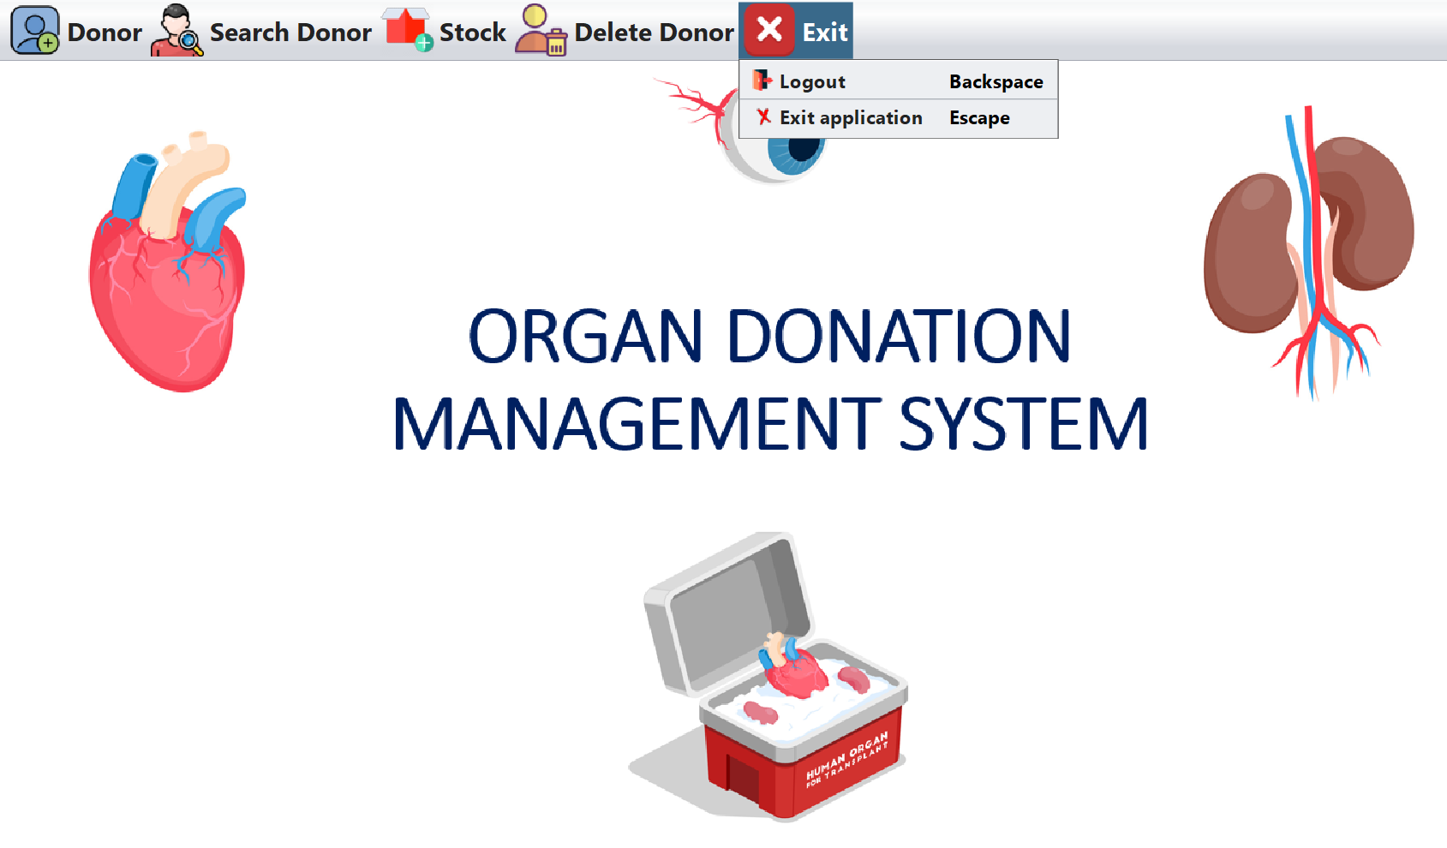
EXIT PAGE

Slide 30
CONCLUSION
The system provides better, faster, and useful.
The way for the citizens to communicate with the blood and organ donor for blood and organ requirement in times of medical emergency. The Organ Donation Management System is a DBMS based application that helps to reduce the mistakes which are done in the existing systems. The Organ Donation Management System is an efficient and reliable blood donor information.

Slide 31
REFERENCE
1. https://www.academia.edu/98144794/ORGAN_DONATION_M ANAGEMENT_SYSTEM_PROJECT_ODMS_
2. https://ieeexplore.ieee.org/document/9537073
3. https://www.internationaljournalssrg.org/uploads/specialissuep df/ICIMCEH-2020/2020/CSE/P105.pdf
4. https://edubirdie.com/examples/the-online-organ-donationmanagement-system-analytical-essay

Slide 32
THANK YOU

